Slide 1
USE OF OATS IN SKIN CARE
Oats in Skin Care
Notes:
This presentation will present information supporting the use of oat-containing products for skin care.

Slide 2
Historic Perspectives on Oats
Common or wild oat (Avena sativa) has a long history of traditional folk use, particularly in poultices or soaks
The use of oats in skin care dates back to 2000 BC in Egypt and the Arabian peninsula
Colloidal oatmeal acknowledged by the Food and Drug Administration (FDA)
  1989: safe and effective (Category I ingredient)
  2003: skin protectant monograph
Brown DJ, Dattner AM. Arch Dermatol. 1998;134(11):1401-1404.
Baumann L. Skin & Allergy News. 2004;35:44-45.
Kurtz ES, Wallo W. J Drugs Dermatol. 2007;6(2):167-170.
Notes:
Like many botanical products, the common or wild oat (Avena sativa) has a long history of traditional folk use, particularly in poultices or soaks.
The use of oats in skin care dates back to 2000 BC in Egypt and the Arabian peninsula. Oats have been used internally and externally for conditions such as insomnia, anxiety, and skin conditions, and in forms ranging from tea to baths. Oatmeal baths were frequently used in the 19th and early 20th centuries for various cutaneous conditions, particularly pruritic inflammatory outbreaks.
Oatmeal is one of the few natural products or ingredients acknowledged by the Food and Drug Administration (FDA). In 1989 the FDA recognized colloidal oatmeal as safe and effective (Category I ingredient) and, in 2003, included colloidal oatmeal as a skin protectant in the final monograph.
Baumann L. Oatmeal. Skin & Allergy News. 2004;35:44-45.
Brown DJ, Dattner AM. Phytotherapeutic approaches to common dermatologic conditions. Arch Dermatol. 1998;134(11):1401-1404.
Kurtz ES, Wallo W. Colloidal oatmeal: history, chemistry and clinical properties. J Drugs Dermatol. 2007;6(2):167-170.
Skin protectant drug products for over-the-counter human use; final monograph. 68FR33362. 2003; June 4.
Derived from
Slide 1 from “Colloidal Oatmeal slides

Slide 3
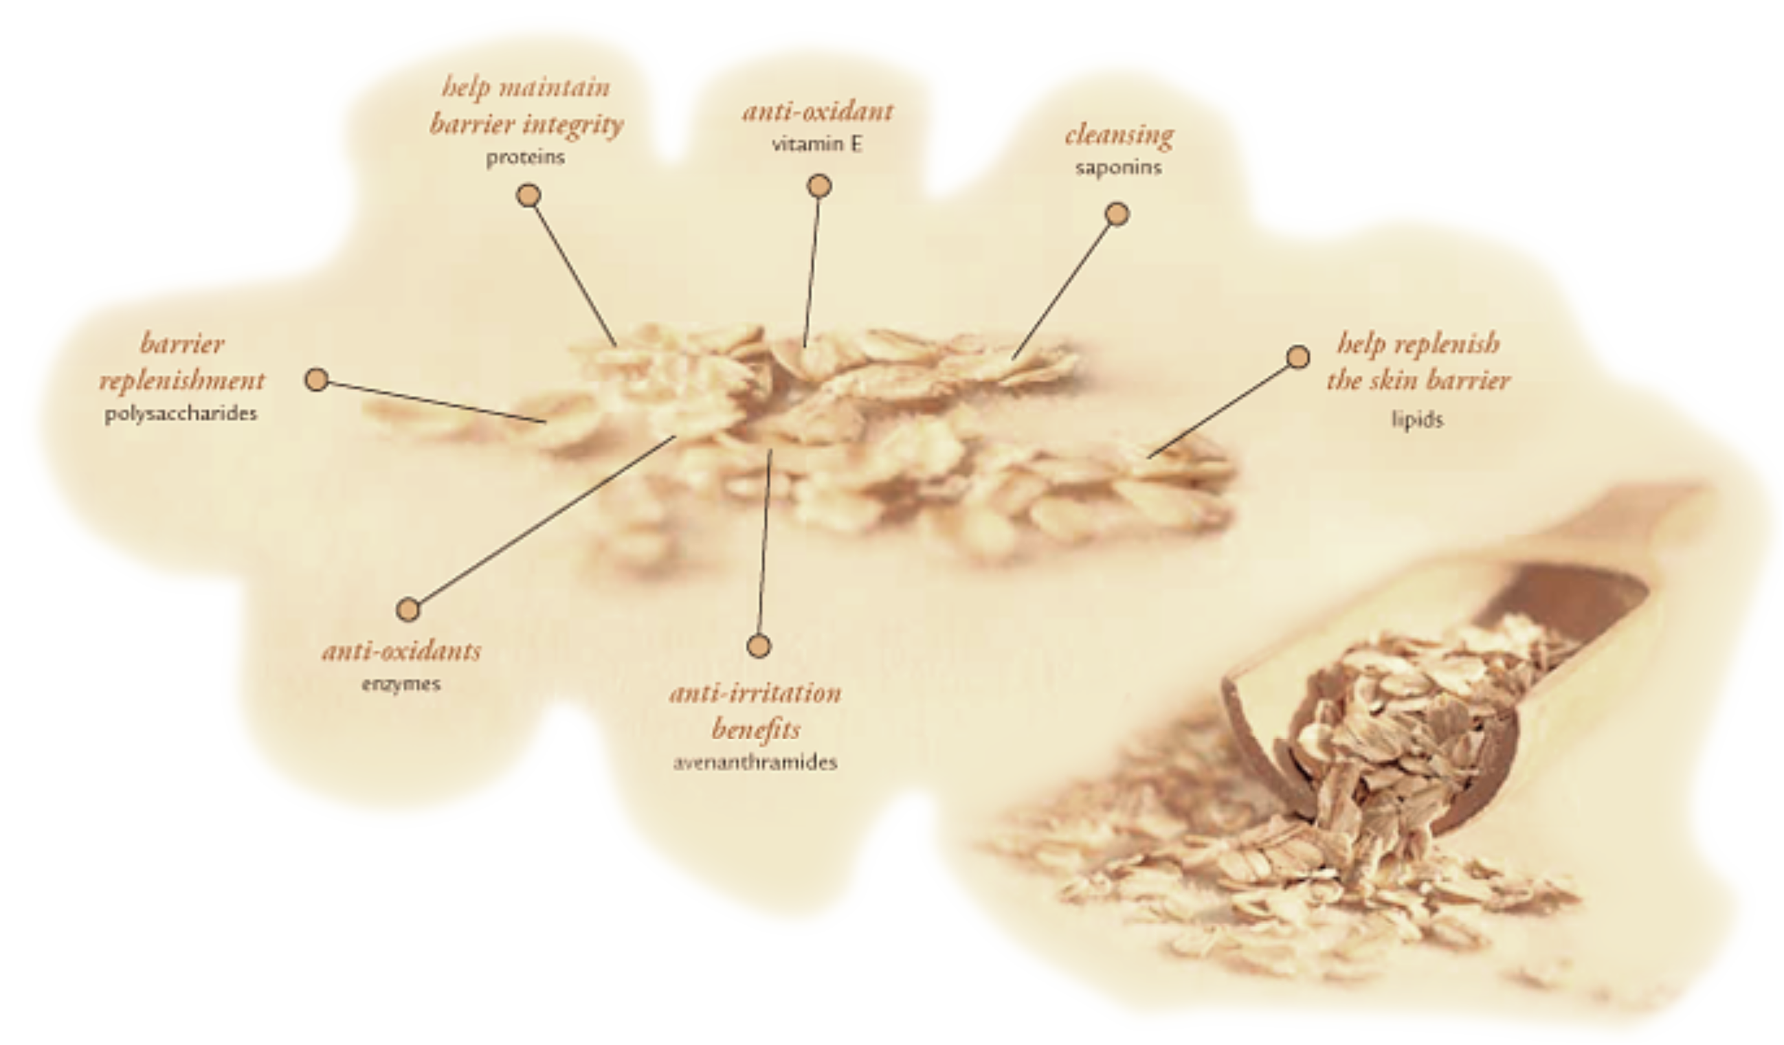
Attributes of Colloidal Oats in Skin Care
Notes:
Colloidal oatmeal is produced as a fine powder from the grinding and processing of whole oat grains.
In addition to polysaccharides, which comprise the largest portion (60%–64%), colloidal oatmeal contains approximately 12.5% to 18% proteins and 3% to 9% lipids. Colloidal oatmeal also contains vitamins A, E, and B; antioxidants (phenolic compounds), anti-inflammatories (prostaglandin inhibitors), saponins, which serve as cleansers and preservatives; and enzymes (superoxide dismutase).
We will focus on 2 main components—avenanthramides and oat lipids.
Kurtz ES, WalloW. Colloidal oatmeal: history, chemistry and clinical properties. J Drugs Dermatol. 2007;6(2):167-170.
Cerio R, Dohil M, Jeanine D, Magina S, Mahé E, Stratigos AJ. Mechanism of action and clinical benefits of colloidal oatmeal for dermatologic practice. J Drugs Dermatol. 2010;(9):1116-1120.
Zhou M, Robards K, Glennie-Holmes M, Helliwell S. Oat lipids. J Am Oil Chem Soc. 1999;76:159-169.
Picture from web site

Slide 4
avenanthramides
Notes:
Much of the recognized benefit of oats results from its phenolic components. The most active of these compounds are the avenanthramides .
Dimberg LH, Theander O, Lingert H. Avenanthramides – a group of phenolic antioxidants in oats. Cereal Chemistry. 1993;70:637-641.

Slide 5
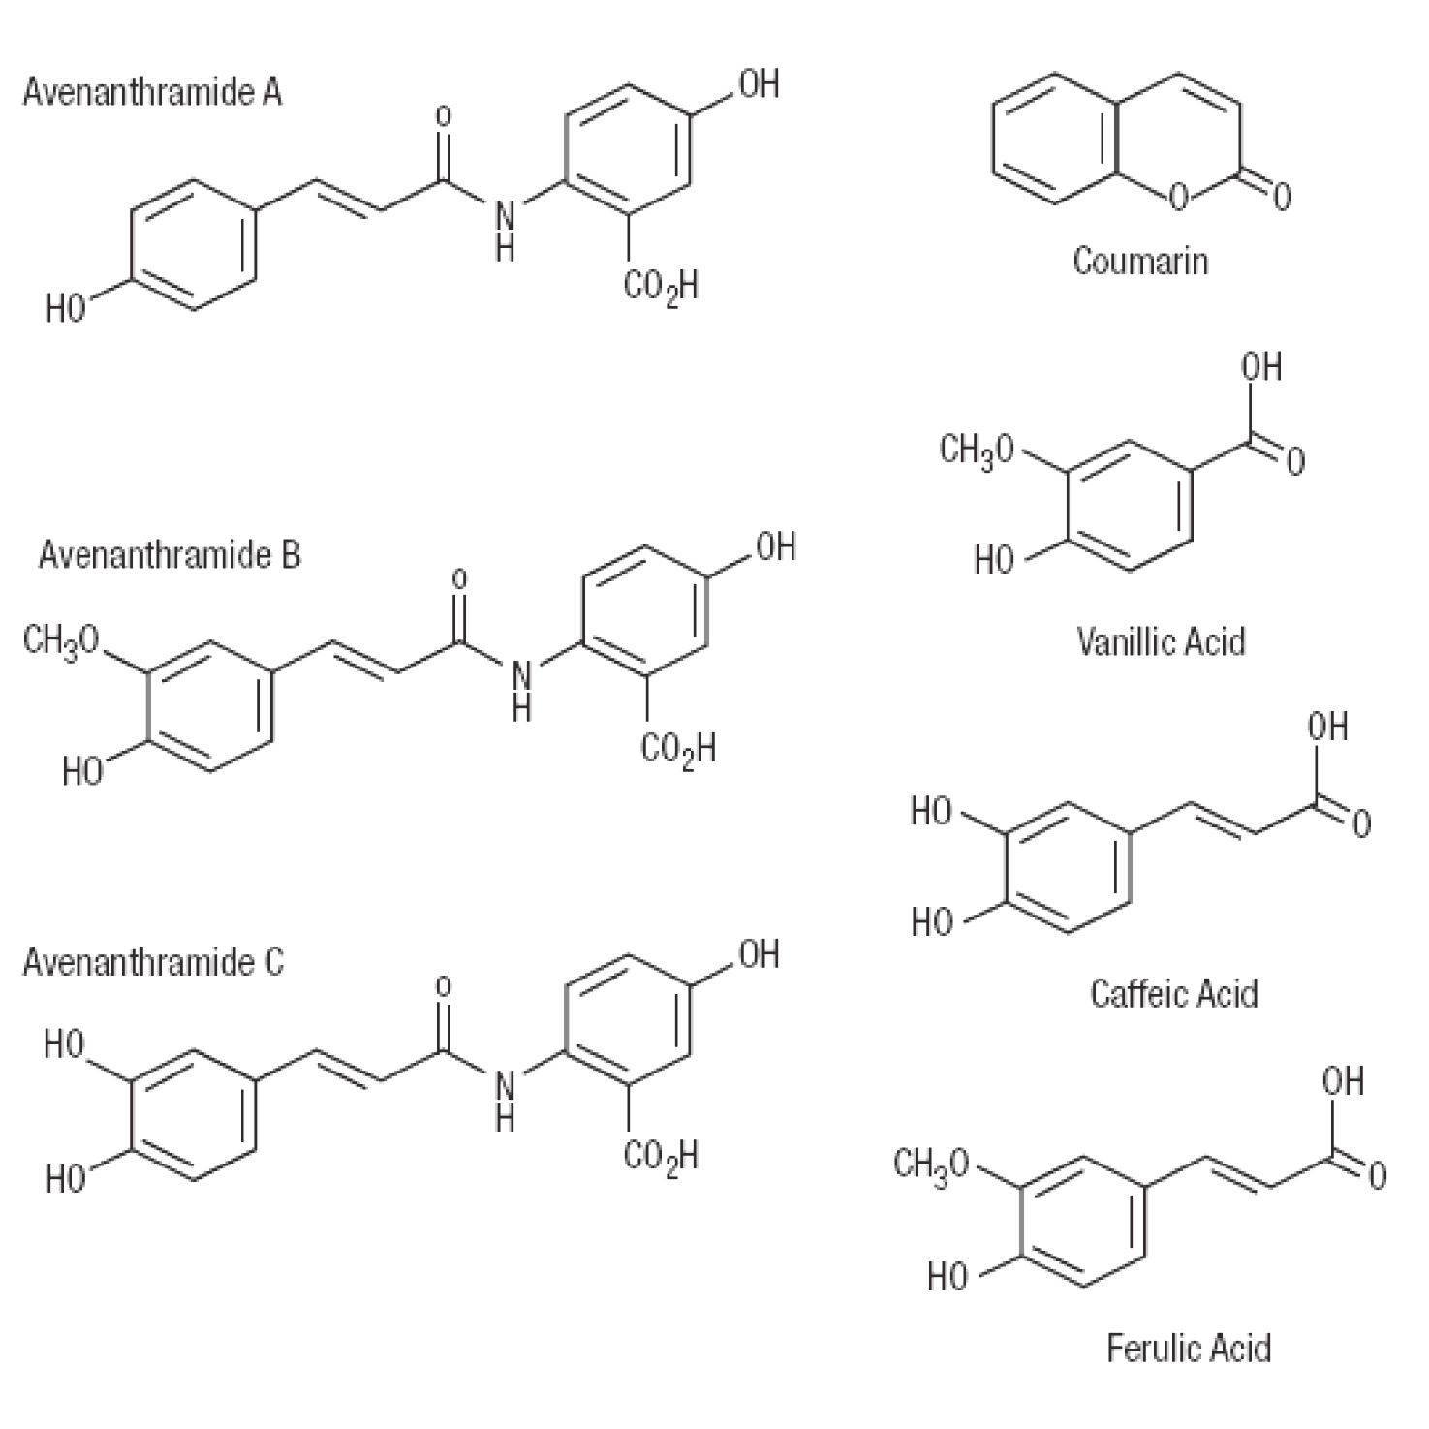
Active Phytochemicals in Oats
Eichenfield LF, et al. Cutis. 2007;80(6 suppl):2-16.
Notes:
Oat phenolic compounds include simple forms with a single phenol ring, such as ferulic acid, caffeic acid, and vanillic acid; complex compounds with 2 or more rings such as coumarin; and the avenanthramides, a class of more than 40 phenolic compounds found only in oats.
Avenanthramides may be of particular value in restoring the cutaneous barrier and reducing symptoms of atopic dermatitis.
Eichenfield LF, Fowler JF Jr, Rigel DS, Taylor SC. Natural advances in eczema care. Cutis. 2007;80(6 suppl):2-16.
Emmons CL, Peterson DM. Crop breeding, genetics & cytology; antioxidant activity and phenolic content of oats as affected by cultivar and location. Crop Science. 2001;41:1676-1681.
http://www.activenaturalsinstitute.com/library_avenanthramides

Slide 6
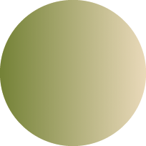
Avenanthramides vs other oat fractions
The avenanthramide fraction is the most effective oat component in reducing UV-induced redness 24 hours after dermal application
Avenanthramides
Flavonoids
Saponins
0
50
100
150
200
250
% of redness attenuation per gram after
UV irradiation. Measure 24h after application
Separated oat fractions tested in a skin erythema model/Patients received 1.5 MED of UVB/Products applied 24 hours after irradiation/Clinical erythema evaluation 24 hours after product application
Vollhardt J, Fielder DA, Redmont MJ. Identification and cosmetic application of powerful anti-irritant constituents
of oat grain. XXI IFSCC International Congress 2000, Berlin. Proceedings; 395-402.
Notes:
In a skin erythema model, separated oat fractions were tested to further explore the functional properties of various oat components. Compared to saponins, flavonoids, sugars and amino acids, ash, proteins, and lipids, the avenanthramide fraction most effectively reduce UV-induced erythema 24 hours after skin application.
Vollhardt J, Fielder DA, Redmont MJ. Identification and cosmetic application of powerful anti-irritant constituents of oat grain. XXI IFSCC International Congress 2000, Berlin. Proceedings; 395-402.
JJ Slide kit FINAL revised text and layout
Slide 22

Slide 7
Avananthramides Inhibit Topical Skin Irritation
270
240
IL-8 Release (pg/mL)
from Keratinocytes
210
180
150
Unstimulated
Stimulated
1
10
100
Avenanthramide (μg/mL)
IL-8=interleukin-8.
Wallo W, et al. Poster presented at: 65th annual meeting of the AAD. February 2-6, 2007; Washington, DC.
Notes:
In preclinical models, avenanthramides were found to decrease the stimulated release of IL-8 from human epidermal keratinocytes. Significant reductions of IL-8 release were obtained with 1, 10, and 100 μg/mL avenanthramides (P<0.05).
Wallo W, Nebus J, Nystrand G, Southall M. Agents with adjunctive potential in atopic dermatitis. Poster presented at: 65th Annual AAD. February 2-6, 2007, Washington, DC.
Slide 39 from “Safety profile of naturals”

Slide 8
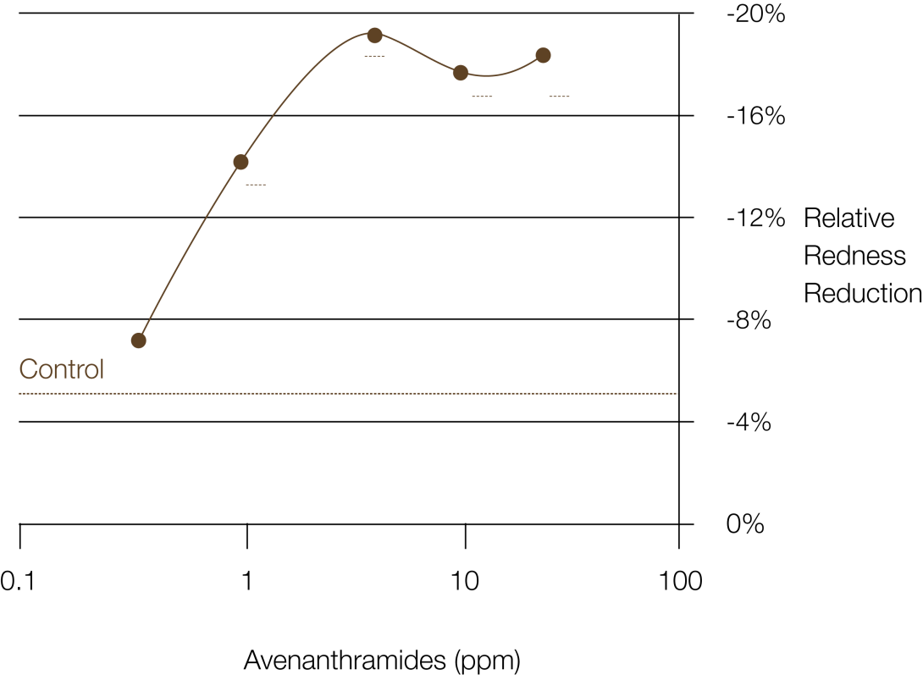
Antioxidant Properties Have Been
Shown to Reduce Erythema
Greatest activity against UV-induced skin erythema 24 hours after application
The purified avenanthramide fractions were applied to a skin erythema model. Significant reduction in skin redness (P<0.05) 24 hours after application when applied in concentrations as low as 1.5 ppm
Vollhardt J, Fielder DA, Redmont MJ. Identification and cosmetic application of powerful anti-irritant
constituents of oat grain. XXI IFSCC International Congress 2000; Berlin. Proceedings; 395-402.
Notes:
This figure shows the results from a study in which the purified avenanthramide fractions were applied to a skin erythema model. Significant reduction in skin redness (P<0.05) 24 hours after application when applied in concentrations as low as 1.5 ppm.
JJ Slide kit FINAL revised text and layout
Slide 25

Slide 9
Oat lipids
Notes:
This section will discuss the properties of oat lipids.

Slide 10
Composition of Oat Lipids
Total lipid content of oats: from 2%–11.8% dry weight
Triglycerides
Phospholipids
Lecithin
Glycolipids
Free fatty acids
  Oleic, Linoleic, Palmitic, Stearic
Zhou M, et al. J American Oil Chem Soc. 1999;76(2):159-169.
Notes:
Now we will turn to the composition of oat lipids. Oats contain a mixture of lipids, including phospholipids that are also found in the outer bilayer of the skin. Thus, oat lipids can help to restore the lipids that are depleted in dry or eczematous skin.
From safety profile of naturals [Joe Fowler 2010 AAD]
Slide 36

Slide 11
Oat Oil Reduces TEWL Compared to Control Sites
TEWL=transepidermal water loss.
Potter RC et al. US Patent 5620692. April 15, 1997.
Notes:
Whole oat oil reduces Transepidermal Water Loss (TEWL) by as much as 56%.
Potter RC, Castro JM, Moffatt LC, inventors; Nature, Inc, assignee. Oat oil compositions with useful cosmetic and dermatological properties. US Patent 5620692. April 15, 1997.

Slide 12
Whole Oat Oil Lipid Class Composition
Southall M, et al. The Dermatologist. September 2012 (suppl):1-4.
Notes:
When fractionated, whole oat oil is composed of contain a mixture of lipids, falling into 4 main lipid classes: triglycerides, diacylglycerol, phospholipids, and free fatty acids, with smaller amounts of sterols, phosphatidylethanolamine, and other compounds.
Southall M, Pappas A, Nystrand G, Nebus J. Oat oil improves the skin barrier. The Dermatologist. September 2012(suppl):1-4.
New slide
The dermatologist
Supplement table 1

Slide 13
Fatty Acid (%) Composition of Oat Oil
 | Phospholipid | Diacylglycerol | Free Fatty Acid | Triglycerides
Palmitic | 12.9 | 15.3 | 16.7 | 14.7
Stearic | 3.2 | 2.3 | 1.9 | 1.6
Oleic | 35.0 | 42.9 | 38.3 | 42.7
Linoleic | 45.3 | 36.1 | 39.2 | 37.0
Southall M, et al. The Dermatologist. September 2012 (suppl):1-4.
Notes:
The majority of the fatty acids are esterified in the triglyceride fraction of oat oil. They are also present in various percentages in each of the 4 lipid classes. For example, 39.2% of linoleic acid is present as free fatty acid, 37% is esterified to triglycerides, 45.3% is esterified to phospholipids, and 36.1% is esterified to diacylglycerol.
Southall M, Pappas A, Nystrand G, Nebus J. Oat oil improves the skin barrier. The Dermatologist. September 2012(suppl):1-4.
New slide
The dermatologist
Supplement table 2

Slide 14
Clinical Evidence Supporting the Use of Oat-Containing Products in Skin Care
Notes:
In this section we will discuss the clinical evidence supporting the use of oat-containing products in skin care.

Slide 15
Skin Conditions Where Colloidal
Oatmeal Has Been Shown Well Tolerated
Contact dermatitis
Rashes
Burns
Postchemotherapy dermatologic toxicity
Atopic dermatitis*
Kurtz ES, Wallo W. J Drugs Dermatol. 2007;6(2):167-170.
Matheson JD, et al. J Burn Care Rehabil. 2001;22(1):76-81.
Alexandrescu DT, et al. Clin Exp Dermatol. 2006;32(1):71-74.
Talsania N, et al. Clin Exp Dermatol. 2007;33(1):97-108.
*Shown in both children and adults.
Notes:
The efficacy of colloidal oatmeal for soothing a range of dermatoses has been established for approximately 50 years. In an early clinical study, colloidal oatmeal was used as a bath and a cleanser for 3 months by 139 patients aged 21 to 91 with various pruritic dermatoses. By the end of the study, more than 71% of these patients achieved complete or marked relief of itchiness.
Kurtz ES, Wallo W. Colloidal oatmeal: history, chemistry and clinical properties. J Drugs Dermatol. 2007;6(2):167-170.
Matheson JD, Clayton J, Muller MJ. The reduction of itch during burn wound healing. J Burn Care Rehabil. 2001;22(1):76-81.
Alexandrescu DT, Vaillant JG, Dasanu CA. Effect of treatment with a colloidal oatmeal lotion on the acneiform eruption induced by epidermal growth factor receptor and multiple tyrosine-kinase inhibitors. Clin Exp Dermatol. 2006;32(1):71-74.
Talsania N, Loffeld A, Orpin SD. Colloidal oatmeal lotion is an effective treatment for pruritus caused by erlotinib. Clin Exp Dermatol. 2007;33(1):108.
Slide 4 from “Skin deck”
Note:
This slide was taken directly from “skin deck” –which included the seborrheic dermatitis bar. There was mention of seborrheic dermatitis in Kurtz article, but since it is not a use you are familiar with, I changed to rashes.

Slide 16
Buffering Capacity of Colloidal Oatmeal Restores the pH of Damaged Skin to Within the Normal Range
ECZEMA (N=33)
(N=33)
WINTER ITCH
SENILE PRURITUS
pH LEVEL IMMEDIATELY AFTER TREATMENT WITH COLLOIDAL OATMEAL
(N=16)
SENILE SKIN
(N=14)
PH
pH LEVEL BEFORE TREATMENT
pH measured on forearm
NORMAL pH RANGE 4.2-5.5
Grais M. AMA Arch Derm Syphilol.1953;68(4):402-407.
Notes:
The buffering capacity of colloidal oatmeal restores the pH of damaged skin to within the normal range.
Grais ML. Role of colloidal oatmeal in dermatologic treatment of the aged. AMA Arch Derm Syphilol. 1953;68(4):402-407.
JJ Slide kit FINAL revised text and layout
Slide 20

Slide 17
Colloidal Oatmeal Cream vs Rx Barrier Emulsion for Improving Skin Barrier in Moderate-to-Severe Dry Skin
Colloidal Oatmeal Cream
Rx Skin Barrier Emulsion
-15
Regression
Period
-20
Percent Mean Reduction in
Water Loss
-25
-30
-35
1
4
7
9
Days
Nebus J, et al. J Am Acad Dermatol. 2011;64:AB71.
Notes:
Colloidal oatmeal also improves the skin barrier in moderate-to-severe dry skin.
In a clinical study of 27 female subjects, use of colloidal oatmeal cream (blue line) showed significant improvements in TEWL values indicating an improvement in the skin barrier comparable to an prescription barrier emulsion. TEWL is a key feature of barrier dysfunction.
Nebus J, Nystrand G, Schmalenberg K, et al. Comparing the effectiveness of an oatmeal cream versus a prescription device cream in improving skin moisturization and barrier function in moderate to severe dry skin. J Am Acad Dermatol. 2011;64:AB71.
N= 27
Skin deck
Slide 9

Slide 18
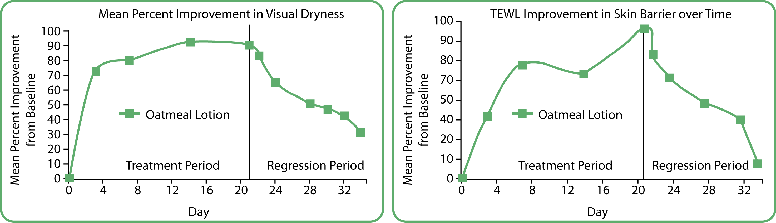
Oatmeal Lotion Use for Moderate-to-Severe Xerosis
Visual Dryness
Transepidermal Water Loss (TEWL)
Nebus J, Schmalenberg K, Wallo W. The effectiveness of an oatmeal lotion in improving and maintaining barrier function and moisture levels of moderate to severe xerosis. P1608.
Notes:
A 5-week clinical study was conducted to demonstrate the effectiveness of an oatmeal, skin protectant lotion in improving the moisture and barrier function of moderate-to-severe dry skin and to measure the residual skin effects after treatment is stopped.
Following a conditioning period, subjects used an oatmeal skin protectant lotion on their lower leg twice a day for a period of three weeks (Days 1–21). For the following 2 weeks (Days 22–34), subjects did not use the test product or any other lotions on their legs.
A total of 50 subjects completed the study. Subjects were female, between the
ages of 18 to 65 years old, with moderate-to-severe dry skin on both lower legs at the time of enrollment.
In the figure on the left, you can see that expert grader evaluations showed significant improvement (P<0.05) in visual dryness at all time points when compared to baseline values. In the figure on the right, significant improvements (P<0.05) in the skin barrier were observed during all time points of the treatment phase of the study (Days 3, 7, 14, 21) and up to Day 9 of the regression phase (no treatment) when compared to the baseline mean score.
Skin was also significantly more hydrated at all time periods measured during the study (data not shown).
Nebus J, Schmaalenberg K, Wallo W. The effectiveness of an oatmeal lotion in improving and maintaining barrier function and moisture levels of moderate to severe xerosis. P1608
New slide from poster

Slide 19
Colloidal Oatmeal Bath* in the Treatment of Dry and Sensitive Skin in Atopic Dermatitis
4-week, investigator-blinded, crossover study (N=25)
1.2
50%
1.0
0.8
Itching
0.6
Grading Score
Burning
0.4
0.2
67%
0
Before
After
*Colloidal oatmeal with ceramides and dexpanthenol.
Wallo W, et al. Poster presented at: 65th annual meeting of the AAD; February 2–6, 2007; Washington DC.
Notes:
A colloidal oatmeal bath has been shown to reduce itching and burning in the treatment of dry and sensitive atopic skin.
In this 4-week, investigator-blinded, crossover study, 25 subjects (males and females) 12 years or older with a history of atopy and moderately dry legs. Subjects soaked legs for 20 minutes per day for 7 days with an oilated colloidal oatmeal bath. There was a 1-week washout period, followed by crossover to other treatment for 7 days.
This graph shows the 50% reduction in itching and 67% reduction in burning with the colloidal oatmeal bath.
Wallo W, Nebus J, Nystrand G, Southall M. Agents with adjunctive potential in atopic dermatitis. Poster presented at: 65th Annual AAD. February 2–6, 2007, Washington, DC.

Slide 20
Daily Oat-Based Skin Care Regimen for Atopic Skin: IGA and Itch Severity
Dermatologist Assessment: IGA and Itch Severity (ages 12–60 years)
3
*
*
2
*
*
*
*
Mean Scores
1
IGA
Itch
0
Week 0
Week 2
Week 4
Week 8
*Significant improvement (P<0.01).
IGA=Investigator’s Global Assessment.
Fowler JF, et al. J Drugs Dermatol. 2012;11(7):804-807.
Notes:
20
An 8-week monadic, blinded, clinical study was conducted to evaluate the tolerance and efficacy of an oat-based skin care regimen in subjects with mild-to-moderate atopic dermatitis. Twenty-five subjects between 12 and 60 years of age (approximate
mean age 30 years) completed the 8-week treatment, which consisted of:
an oat-based body cream to be used twice daily, morning and night (or more often if needed); and 2) an oat-based body wash, used once a day in the shower or bath. Subjects were allowed to use their prescribed topical treatment as per their usual routine. Evaluations were performed at Weeks 0, 2, 4, and 8. Evaluations included Eczema Area and Severity Index (EASI), investigator’s global assessment (IGA), and subjective assessment so itching, burning and stinging (1–4 scale).
Dermatologist evaluations showed a statistically significant (P<0.01) improvement in the IGA scores (green line) and in itch severity (orange line) at Weeks 2, 4, and 8.
Fowler JF, Nebus J, Wallo W, Eichenfield LF. Colloidal oatmeal formulations as adjunct treatments in atopic dermatitis. J Drugs Dermatol. 2012;11(7):804-807.
Slide 8 from “Skin deck”
Notes from poster

Slide 21
Daily Oat-based Skin Care Regimen for Atopic Skin: EASI Composite Score
Dermatologist Assessment: EASI Composite Score (ages 12–60 years)
8
6
EASI (Mean)
4
*
*
*
2
0
Baseline
Week 2
Week 4
Week 8
EASI=eczema area and severity index .
*Significant improvement (P<0.001).
Fowler JF, et al. J Drugs Dermatol. 2012;11(7):804-807.
Notes:
21
In addition, dermatologist evaluations showed a statistically significant (P<0.001) improvement in EASI composite scores at Weeks 2, 4 and 8.
Fowler JF, Nebus J, Wallo W, Eichenfield LF. Colloidal oatmeal formulations as adjunct treatments in atopic dermatitis. J Drugs Dermatol. 2012;11(7):804-807.
Slide 9 from “Skin deck”

Slide 22
Daily Oat-Based Skin Care Regimen for Atopic Skin: Improvement in IGA Over Time
Dermatologist Assessment: IGA Over Time (Ages 12–60 years)
IGA=Investigator’s assessment
Fowler JF, et al. J Drugs Dermatol. 2012;11(7):804-807.
Notes:
As illustrated, IGA also improved over time. The percent of patients with moderate and mild atopic skin declined (red and orange bars), while the percentage of patients with almost clear and clear skin increased (yellow and green bars).
Fowler JF, Nebus J, Wallo W, Eichenfield LF. Colloidal oatmeal formulations as adjunct treatments in atopic dermatitis. J Drugs Dermatol. 2012;11(7):804-807.
New slide
From poster

Slide 23
Colloidal Oatmeal Regimen for Babies and Children with Atopic Dermatitis
*P<0.001. †P<0.05
N=23 children aged 2 months to 6 years.
Fowler JF, et al. J Drugs Dermatol. 2012;11(7):804-807.
Notes:
A 4-week, monadic study was performed to assess the safety and tolerance of a colloidal oatmeal regimen (cream and cleanser) on babies and children with mild to moderate atopic dermatitis involving at least 5% body surface area. All patients used the occlusive colloidal cream twice daily and the colloidal oatmeal glycerin cleanser for routine bathing. They continued any topical prescription medication already in use. An independent dermatologist performed evaluations at baseline, Week 2, and Week 4.
A total of 23 patients aged 3 months to 5 years of age (mean age, 2.4 years) were enrolled in the study. At baseline, 30% had moderate and 70% had mild eczema according to Investigators Global Assessment (IGA). After using the regimen for 4 weeks, 60% were classified as clear or nearly clear.
As shown, overall IGA and Eczema Area and Severity Index (EASI) composite score were significantly improved from baseline (P<0.001 and P<0.05, respectively) at both week 2 and week 4.
Fowler JF, Nebus J, Wallo W, Eichenfield LF. Colloidal oatmeal formulations as adjunct treatments in atopic dermatitis. J Drugs Dermatol. 2012;11(7):804-807.
New slide
Fowler 2012 figure 2

Slide 24
Tolerability and Efficacy of a Colloidal Oatmeal Cream and Cleanser in Infants and Children with mild to moderate Atopic Dermatitis
Dermatologist Assessments: (age 2 months–6 years)
Week 2
60
Week 4
50
*
*
*
*
*
*
40
Percent Mean Improvement
30
20
10
0
Dryness
Roughness
Itch (VAS)
P<0.05 vs baseline for all comparisons.
VAS=visual analog scale.
Lee PW, et al. Poster presented at: 34th Annual Meeting of the Society of Pediatric Dermatology, July 2008.
Notes:
24
In another study, infants and children aged 2 months to 6 years of age, the majority of whom presented with atopic dermatitis used the regimen of colloidal oatmeal and cleanser for 4 weeks.
Dermatologist evaluations at 2 and 4 weeks showed significant improvements in dryness, roughness, and itch.
Lee PW, Krakowski A, Chayavichitsilp P, Nebus J, Wallo W, Eichenfield LF. Evaluating the tolerance of a colloidal oatmeal cream and cleanser in infants and children with atopic dermatitis. Poster presented at: 34th Annual Meeting of the Society of Pediatric Dermatology, July 2008.
Slide 4 from “colloidal oatmeal slides”

Slide 25
Tolerability and Efficacy of a Colloidal Oatmeal Cream and Cleanser in Infants and Children with Atopic Dermatitis
Dermatologist Assessments: IGA and EASI Composite Score
60
50
40
Percent Mean Improvement
30
20
Overall IGA
EASI Composite
10
0
Week 2
Week 4
P<0.05 vs baseline for all comparisons.
IGA=Investigator’s Global Assessment; EASI=eczema area severity index.
Lee PW, et al. Poster presented at: 34th Annual Meeting of the Society of Pediatric Dermatology, July 2008.
Notes:
25
Dermatologist assessment demonstrated significant improvements (P<0.05) in mean scores for IGA (green line) and EASI (red line) composite scoring at Weeks 2 and 4 compared with baseline when using the oat-based skin care regimen.
Lee PW, Krakowski A, Chayavichitsilp P, Nebus J, Wallo W, Eichenfield LF. Evaluating the tolerance of a colloidal oatmeal cream and cleanser in infants and children with atopic dermatitis. Poster presented at: 34th Annual Meeting of the Society of Pediatric Dermatology, July 2008.
Slide 5 from “colloidal oatmeal slides”

Slide 26
Colloidal Oatmeal Cream for Eczema:
Study Methods
NOVEMBER 2010
MAY 2011
Patient enrolment
T0 baseline assessment
T4 weeks assessment
T8 weeks assessment
T12 weeks assessment
Usual moisturizer stopped
Use of basic moisturiser
Colloidal Oatmeal Cream 2 x day
Face, body, & eczema areas
Colloidal Oatmeal Cream 2 x day
Face, body, & eczema areas
Colloidal Oatmeal Cream 2 x day
Face, body, & eczema areas
1 month
washout
1 month
2 months
3 months
Patients with a score of 0
at T0 did not enter trial
Any patients with a score of 0
did not enter the analysis
Colloidal Oatmeal Cream was used as part of the patient’s normal skin regimen; no other product changes were made
Data on file. Johnson and Johnson, 2012.
Notes:
In the next few slides, we will discuss an international, multicenter, open-label, 12-week study conducted in Portugal, Italy, and Greece. The objective of the study was to assess the efficacy of a soothing colloidal oatmeal emollient cream to improve the signs of atopic skin. A total of 99 patients, aged 6 months to adult, with mild-to-moderate eczema were enrolled in the study. More than 60% of enrollees were ≤5 years of age.
This graphic illustrates the study protocol. After a 1-month washout period, patients with a score >T0 entered the study. Patients applied colloidal oatmeal cream twice daily on the face, body, and affected eczema areas. They were instructed to continue their normal skin regimen. Evaluations were conducted at 4, 8, and 12 weeks. Any patient who had a score of 0 at the 1- or 2-month evaluation did not enter the analysis. A total of 71 patients were used in the efficacy analyses.
Dermexa deck
Slide 3
Not sure what you want to use for ref for these slides. I used DOF—let me know if you wish to change.

Slide 27
SCORAD and EASI
Severity Scoring of Atopic Dermatitis (SCORAD)
  Composite index
  Assesses spread of lesion area, intensity of lesions, and symptoms
  Calculated score classifies atopic skin as mild, moderate, or severe
Eczema Area and Severity Index (EASI)
  Composite index
  Assesses percent of body surface area involved and skin pathology
  Calculated score ranges from 0 to 72
  European Task Force on Atopic Dermatitis. Dermatology. 1993;186:23-31.
Hanifin JM, et al. Exp Dermatol. 2001;10:11-18.
Notes:
The Severity Scoring of Atopic Dermatitis (SCORAD) and Eczema Area and Severity Index (EASI) are 2 methods of measuring eczema severity.
The SCORAD is a reference tool for the follow-up and evaluation of atopic dermatitis. It is a composite measure of overall skin condition, and assesses a variety of skin parameters, including spread of lesion area, intensity of lesions, and symptoms. Based on these parameters, a composite score is calculated and the skin impairment is classified as mild, moderate, or severe.
The EASI is another composite index that includes an assessment of disease extent and percent of body surface area involved in 4 body regions (head and neck, lower limbs, upper limbs, and trunk). The EASI also includes an assessment of skin pathology (erythema, infiltration and/or papulation, excoriation, and lichenification, each on a scale from 0 to 3. A composite score is calculated based on these assessments for each body region affected. The minimum score for EASI is 0 and the maximum is 72.
European Task Force on Atopic Dermatitis. Severity scoring of atopic dermatitis: the SCORAD index. Consensus report of the European Task Force on Atopic Dermatitis. Dermatology. 1993;186:23-31.
Hanifin JM, Thurston M, Omoto M, Cherill R, Tofte SJ, Graeber M, the EASI Evaluator Group. The eczema area and severity index (EASI): assessment of reliability in atopic dermatitis. Exp Dermatol. 2001;10(1):11-18.
Dermexa deck
Slide 6; notes from slide 5

Slide 28
All Signs of Mild-to-Moderate Eczema
Improved as Skin Hydration Increased
Percentage of patients with improvement in clinical parameters
Percent Mean Improvement
Data on file. Johnson and Johnson, 2012.
*All patients, visual assessment by dermatologist
Notes:
At Week 12 (green bar), 100% of patients had improvement in skin hydration, 96% had improvement in pruritus, 82% had improvement in scaling, and 88% had improvement in erythema.
Dermexa deck
Slide 13
Highlights from slide 13 and 14 to notes

Slide 29
Colloidal Oatmeal Cream Was Effective in the Younger Age Group* From Week 4
*Children from 6 months to 5 years; visual assessment by dermatologist
**
*
**
**
*
*
Percent Mean Improvement
**
*
**
*
**
T4W
T8W
T12W
T4W
T8W
T12W
T4W
T8W
T12W
T4W
T8W
T12W
Dryness
Itching
Scaling
Redness
All parameters improved either significant* or highly significant**
Data on file. Johnson and Johnson, 2012.
Notes:
As illustrated, colloidal oatmeal cream was effective in the younger age group (defined as 6 months to 5 years of age) beginning at Week 4.
Dermexa deck
Slide 15

Slide 30
And in Older Children and
Adolescents
Subjects from 6–20 years, visual assessment by dermatologist
Percentage improvement compared with baseline visit (6–20 years old)
**
**
*
*
*
**
**
Percent Mean Improvement
*
*
*
T4W
T8W
T12W
T4W
T8W
T12W
T4W
T8W
T12W
T4W
T8W
T12W
Dryness
Itching
Scaling
Redness
*Significant improvement; **Highly significant improvement
Data on file. Johnson and Johnson, 2012.
Notes:
Colloidal oatmeal cream was also effective in children and adolescents 6 to 20 years of age.
Dermexa deck
Slide 15

Slide 31
More than 80% of Patients in All Age
Groups Saw Improvement in Their Skin Condition
Percentage of patients with improvement in skin condition at Week 12
Data on file. Johnson and Johnson, 2012.
**Assessment by parents for the very young
Notes:
Patients agreed with dermatologists’ assessments; more than 80% of patients indicated they had improvement in all measured parameters.
Dermexa deck
Slide 18

Slide 32
Improvement in SCORAD (Week 12)
At Week 12, more than 90% of patients had
improvement in SCORAD scores
  Overall, SCORAD scores improved by a mean of 48.4%
  In infants and young children (≤5 years of age), the mean improvement in SCORAD scores was 37.1%
  In children and adolescents (6–20 years of age), the mean improvement in SCORAD scores was 57.7%
Data on file. Johnson and Johnson, 2012.
Notes:
SCORAD scores also improved. Overall, more than 90% of patients had improvement in SCORAD at Week 12. The mean percentage improvement was 37% for children ≤5 years of age, 58% for children and adolescents 6 years to 20 years of age, and 48% overall.
Dermexa deck
Slide 15

Slide 33
Colloidal Oatmeal Cream Effect on Corticosteroid use
As skin conditions improved with regular use of the colloidal oatmeal cream, subjects reported a decreased need for corticosteroid use.
During the washout period, patients averaged 5.5 grams of corticoids
After 4 weeks of using colloidal oatmeal cream
  Measured corticosteroid use declined by 39.4% (9.24 grams/patient)*
  63% of patients felt that they used less corticoids/immunomodulators†.
*N=19, based on subset of individuals using topical corticosteroids prior to study start. Average use, 2.4 tubes over 12 week study period.
†Self assessment questionnaire.
Data on file. Johnson and Johnson, 2012.
Notes:
Regular use of colloidal oatmeal cream was also shown to have a corticosteroid-sparing effect as the condition improved. After 4 weeks of using colloidal oatmeal cream, measured corticosteroid use declined by 39.4% and 63% of patients felt that they used less corticoids/ immunomodulators.

Slide 34
Safety
Oat Sensitization
Notes:
This section will review studies evaluating the potential for oat products to cause sensitization.

Slide 35
Reports of Oat Sensitization
Study | N | Age | Design | Formulation | Tests | Results
Boussault, 2007¹ | 302 |  | Prospective Open | Oat pollen | APT SPT OFC ROAT | 15% APT+ 19% SPT+ 16% OFC+ 7/25 ROAT+
Pigatto, 1997² | 42 (atopic) 22 (control) | Range: 6–24 months | Double blind Randomized | Colloidal oat extract | Topical application | No urticarial or contact allergy reactions
Grimalt, 2007³ | 173 (atopic) | <12 months | Open label 6 weeks | Oat-based emollient | Steroid-sparing effect | 42% decrease in usage of moderate- and high-potency topical corticoids
Goujon, 2009⁴ | 12 (atopic) | Adults | Open label 45 days | Oat-containing cosmetics and oat extracts | APT SPT RMA | No immediate or delayed reactions
APT=atopy patch testing; OFC=oral food challenge; RMA-repeated and maximized applications; ROAT-repeated open application test; SPT=skin prick test.
Boussault P, et al. Allergy. 2007;62(11):1251-1257.
Pigatto P, et al. Am J Contact Dermat. 1997;8(4):207-209.
Grimalt R, et al. Dermatology. 2007;214(1):61-67.
Goujon C, et al. Dermatology. 2009;218(4):327-333.
Notes:
With the exception of the Boussault study (top row),¹ most evaluations of topical oat-based products, either in atopics or nonatopics, show no propensity toward adverse events. While rare cases of clinically important oat allergy may exist, oat-based products are safe in the treatment of a vast majority of individuals.²⁻⁴
There are methodologic issues with the Boussault study,¹ which showed increased sensitization. First, oat pollen was used for testing, rather than colloidal oatmeal. IgE testing was also done to oat flower and pollen, not oat protein. In prick tests, the reliance on patient history alone in assessing prior use of oat-containing products is problematic. In addition, only 25/302 subjects had a repeated open application test (ROAT) performed, and this test was done at home and unsupervised. Finally, clinical correlation of allergic reactivity and APT is uncertain.
Discussions will continue to occur at dermatology meetings about topical application of food-based ingredients, especially those containing proteins. While individual case studies can be helpful, robust clinical studies provide the best evidence-based information for making informed decisions applicable to daily practice.
Boussault P, Léauté-Labrèze C, Saubusse E, et al. Oat sensitization in children with atopic dermatitis: prevalence, risks and associated factors. Allergy. 2007;62(11):1251-6.
Pigatto P, Bigardi A, Caputo R, et al. An evaluation of the allergic contact dermatitis potential of colloidal grain suspensions. Am J Contact Dermat. 1997;8(4):207-209.
Grimalt R, Mengeaud V, Cambazard F; Study Investigators' Group. The steroid-sparing effect of an emollient therapy in infants with atopic dermatitis: a randomized controlled study. Dermatology. 2007;214(1):61-67.
Goujon C, Jean-Decoster C, Dahel K, et al. Tolerance of oat-based topical products in cereal-sensitized adults with atopic dermatitis. Dermatology. 2009;218(4):327-333.
From safety profile of naturals [Joe Fowler 2010 AAD]
Slides 40-46

Slide 36
Conclusions on Topical Oat Safety
While some foods may trigger disease flares in atopics, more so in infants, it is not a common occurrence
When foods do cause flares, oats have not been reported as common offenders
The majority of studies of topical oat-based products, either in atopics or non atopics, show no propensity toward adverse events
While rare cases of clinically important oat allergy may exist, oat-based products are safe and effective in the treatment of the vast majority of individuals
Notes:
While some foods may trigger disease flares in atopics, more so in infants, it is not a common occurrence.
When foods do cause flares, oats have not been reported as common offenders.
The majority of studies of topical oat-based products, either in atopics or nonatopics, show no propensity toward adverse events.
While rare cases of clinically important oat allergy may exist, oat-based products are safe and effective in the treatment of the vast majority of individuals.
From safety profile of naturals [Joe Fowler 2010 AAD]
Slide 47

Slide 37
Summary
Colloidal oatmeal is acknowledged by the Food and Drug Administration (FDA) as a safe and effective skin protectant
The efficacy of colloidal oatmeal for soothing a range of dermatoses has been established for approximately 50 years
Much of the recognized benefit of oats are a result of strong skin protectant benefits and from its phenolic components, especially avenanthramides
Oats also contain a mixture of lipids, including phospholipids that are also found in the outer bilayer of the skin
  Whole oat oil reduces TEWL by as much as 56%
The majority of studies of topical oat-based products, either in atopics or nonatopics, show no propensity toward adverse events

